Slide 1
Energy Efficiency Self-Study
Mr. Rogalski
Chaparral High School
Touro University

Slide 2
The Need for Energy Efficiency
Energy Costs are increasing
School Budgets are decreasing
Resources are diminishing
Students unaware of potential energy waste and consumption
Every year, schools around the country face possible budget cuts. They need to find ways to save money. Energy costs keep increasing every year, schools to need find ways to cut those costs.

Slide 3
Preconceptions
Classes will most likely consume the most energy with electronics being left on when not in use.
Computers and projectors being left on over night.
Teachers and students need to turn off any machines when not in use.

Slide 4
Data Collection Method
Students will write down and chart their observance of energy waste in each of their classes.
One week of observations
Share different ideas of wasteful energy amongst peers.

Slide 5
Chart

Slide 6
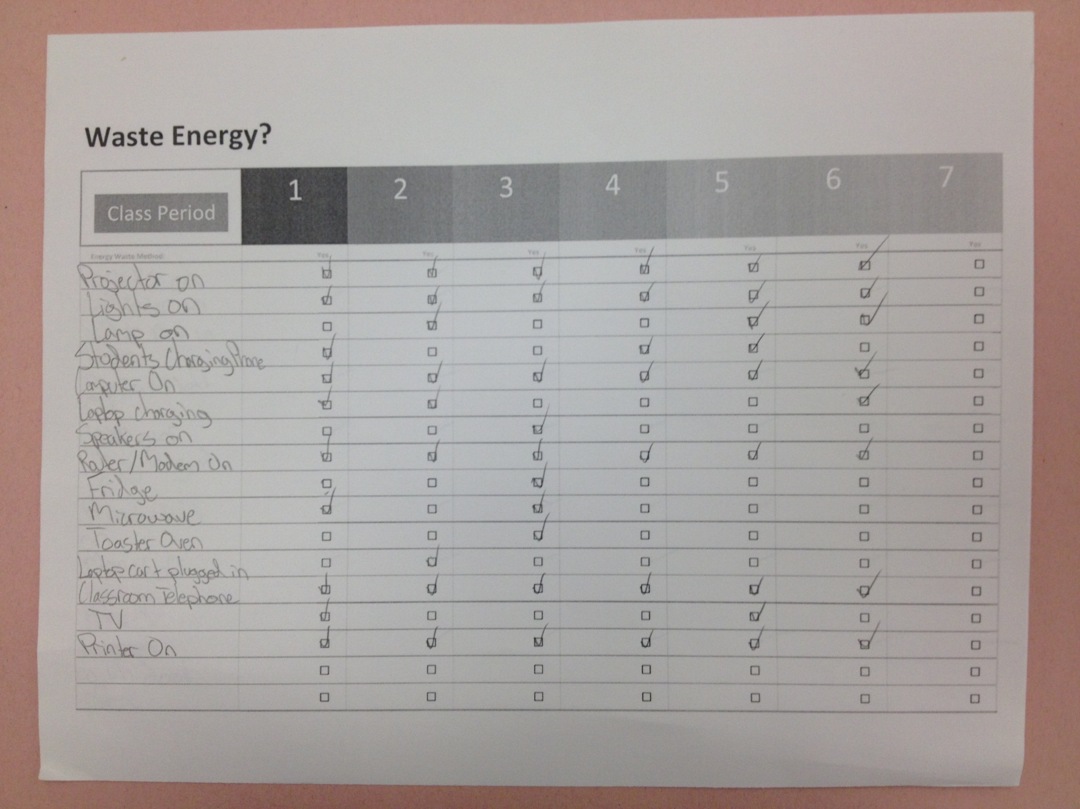
Student 1 Collected Data

Slide 7
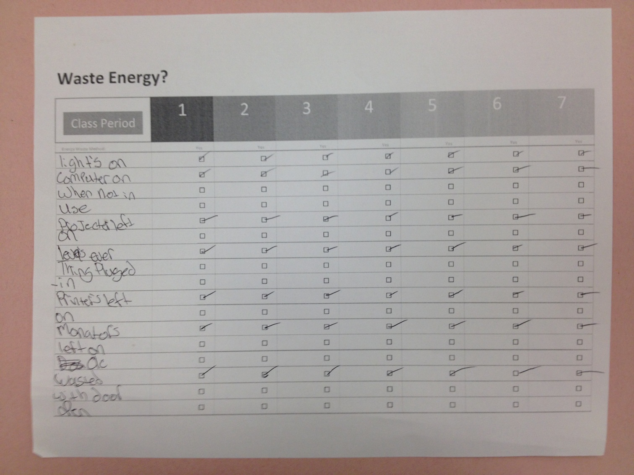
Student 2 Collected Data

Slide 8
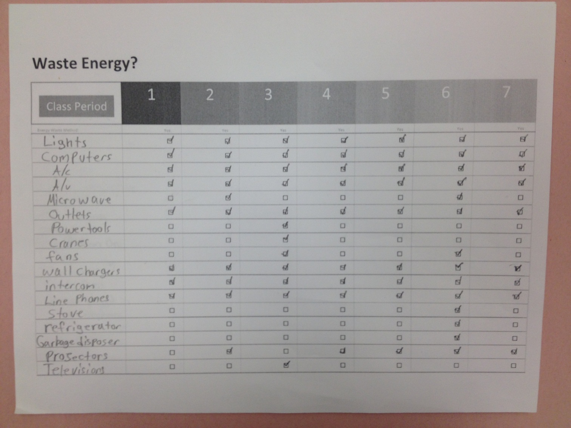
Student 3 Collected Data

Slide 9
Results
Common Ways that energy was observed being wasted wasted/left on when not in use:
All 3 students noted these in every class:
Lights
Computers
A/C
Power Outlets
Wall Chargers
Projectors
Printer
There were other ways some classes wasted energy that other classes didn't:
Power tools
Microwaves
Refrigerators
Stoves
Door left open

Slide 10
Limitations of Study
Not able to measure the exact energy numbers for each appliance
Consistency with data for students
Students not turning in the data on time
Find information regarding energy use and costs for individual school
Offer more incentives for students
  More students
  Better data

Slide 11
Comparing Preconceptions and findings
Computers and Projectors were the top energy wasters in each classroom
Power outlets, phone chargers and printers were newer ideas regarding waste of energy.
Other forms of energy waste also depended on the type of classroom.
  Stove, Fridge, Microwave and other appliances not in other classes, but known to use larger quantities of energy.

