Slide 1
Chaparral High School Student Tech Committee Plan
Mr. Rogalski
Touro Univeristy
EDCI 656 Final

Slide 2
Goals
Create a Student-Oriented Technology Committee within the school to assist classroom teachers during school hours.
Offer training for students and teachers in the use of technology within the classroom.
Show that integrating technology within the school assists in the school’s improvement plan.

Slide 3
Objectives
Students will:
Be trained with diagnosing and repairing technical issues within the classroom.
Assist teachers in accessing properly utilizing technology and online resources.

Slide 4
Ideas of Success
Teachers easily utilizing technology within their classrooms to improve their curriculum.
Little to no issues with technology
No more longstanding technology not being used.
Technical issues solved within the class time they become apparent.
Students find resources for their teachers to use.

Slide 5
Activities
Proper training and online tutorials for technology set-up.
Teach students how to solve basic computer repair and common technology issues.
Educate students on useful websites that have valuable resources they can share with their teachers.

Slide 6
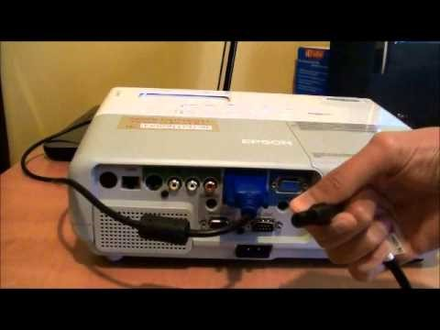
Activities Computer - Projector

Slide 7
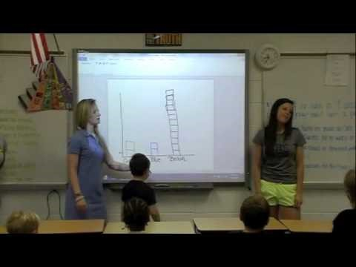
Activities Smartboard

Slide 8
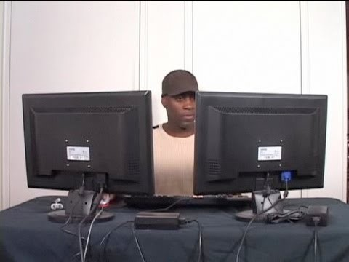
Activities Dual Monitors

Slide 9
Activities PCWorld
PCWorld Link

Slide 10
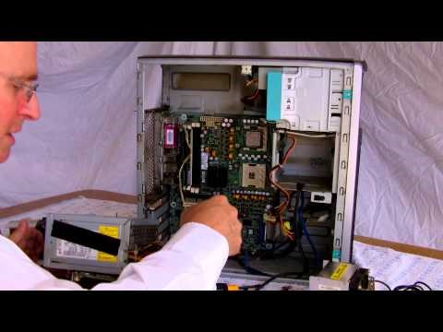
Activities – Maintenance

Slide 11
Activities – Top 100 Websites
Link

Slide 12
Activities – Landmark
Link

Slide 13
Activities – Best History Websites
Link

Slide 14
Standards
ISTE Teacher Standards:
1.b - Engage students in exploring real-world issues and solving authentic problems using digital tools and resources.
1.d - Model collaborative knowledge construction by engaging in learning with students, colleagues, and others in face-to-face and virtual environments
2.b - Develop technology-enriched learning environments that enable all students to pursue their individual curiosities and become active participants in setting their own educational goals, managing their own learning, and assessing their own progress.
3.a - Demonstrate fluency in technology systems and the transfer of current knowledge to new technologies and situations
4.a - Advocate, model, and teach safe, legal, and ethical use of digital information and technology, including respect for copyright, intellectual property, and the appropriate documentation of sources.
5.b - Exhibit leadership by demonstrating a vision of technology infusion, participating in shared decision making and community building, and developing the leadership and technology skills of others.

Slide 15
Standards cont.
ISTE Student Standards:
2.d - Contribute to project teams to produce original works or solve problems.
3.b - Locate, organize, analyze, evaluate, synthesize, and ethically use information from a variety of sources and media.
4.a - Identify and define authentic problems and significant questions for investigation.
4.b - Plan and manage activities to develop a solution or complete a project.
6.c - Troubleshoot systems and applications.

Slide 16
Evaluation
Students will be evaluated on a 10-point system per issue. They will be graded with two categories; Quality of Work and Time-management.
Quality of work – If the technological issue is fixed or not.
Time-management – If the issue was fixed during a certain time-period.
Teachers will evaluate the students and the committee as a whole towards the end of the year.
How successful was the committee?
Ratio of Solved/Unsolved technology issues.
Questions/Concerns/Feedback to the program.

Slide 17
Rubric
Collaborative Work Skills : Student Tech Committee
Teacher Name: Mr. Rogalski
Student Name: ________________________________________
CATEGORY | 5 | 3 | 1 | 0
Quality of Work | Technology issue(s) fixed. | Technology issue(s) mostly fixed. | Technology issue(s) somewhat fixed. | Technology issue(s) not fixed.
Time-management | Technology issue(s) fixed within class time. | Technology issue(s) fixed within day. | Technology issue(s) fixed within week. | Technology issue(s) fixed in a week or more.

